Slide 1

B Tech CSE(AI-DS)
TY Semester V
Subject: AI Systems and Applications
Disclaimer:
Information included in this slides came from multiple sources. We have tried our best to cite the sources. Please refer to the References to learn about the sources, when applicable.
The slides should be used only for academic purposes (e.g., in teaching a class), and should not be used for commercial purposes.

Slide 2
Unit 4 – AI Applications
Artificial Intelligence in Game Development AI Applications in Healthcare, AI in Robotics and Autonomous Systems AI-Driven Innovations in Finance AI for Business Optimization AI Techniques in Marketing AI in Educational Technology AI Solutions for Smart Agriculture

Slide 3
Artificial Intelligence in Game Development
Artificial Intelligence (AI) plays a crucial role in modern game development by making games more realistic, adaptive, and engaging. It enhances both gameplay and development processes through intelligent algorithms, learning systems, and automation tools.

Slide 4
Role of AI in Games
AI in games is primarily used to simulate human-like behavior and create adaptive challenges for players. It helps in:
Controlling non-player characters (NPCs).
Generating procedural content.
Enhancing game balancing and difficulty.
Enabling realistic environments and interactions.

Slide 5
AI Techniques Used in Game Development
Technique | Description | Example Use
Pathfinding (A*) | Finding optimal paths | NPC navigation
Finite State Machines (FSM) | Simple decision logic | Enemy AI states (idle, chase, attack)
Behavior Trees | Hierarchical decision structure | Complex NPC behaviors
Neural Networks | Learning-based adaptation | Player style adaptation
Reinforcement Learning (RL) | AI learns optimal actions | Self-learning agents
Genetic Algorithms (GA) | Evolutionary optimization | Level or character design
Fuzzy Logic | Handling uncertainty | Human-like decision making

Slide 6
heuristic algorithm
A heuristic algorithm is a problem-solving method that uses practical techniques or shortcuts to produce a good enough solution when finding the exact or optimal solution is too time-consuming or complex.
Key Characteristics:
Approximation: It aims for a satisfactory solution, not necessarily the best one.
Speed: Faster than exhaustive or exact algorithms.
Experience-based: Uses intuition, rules of thumb, or domain knowledge.
Trade-off: Balances accuracy with computational efficiency.

Slide 7
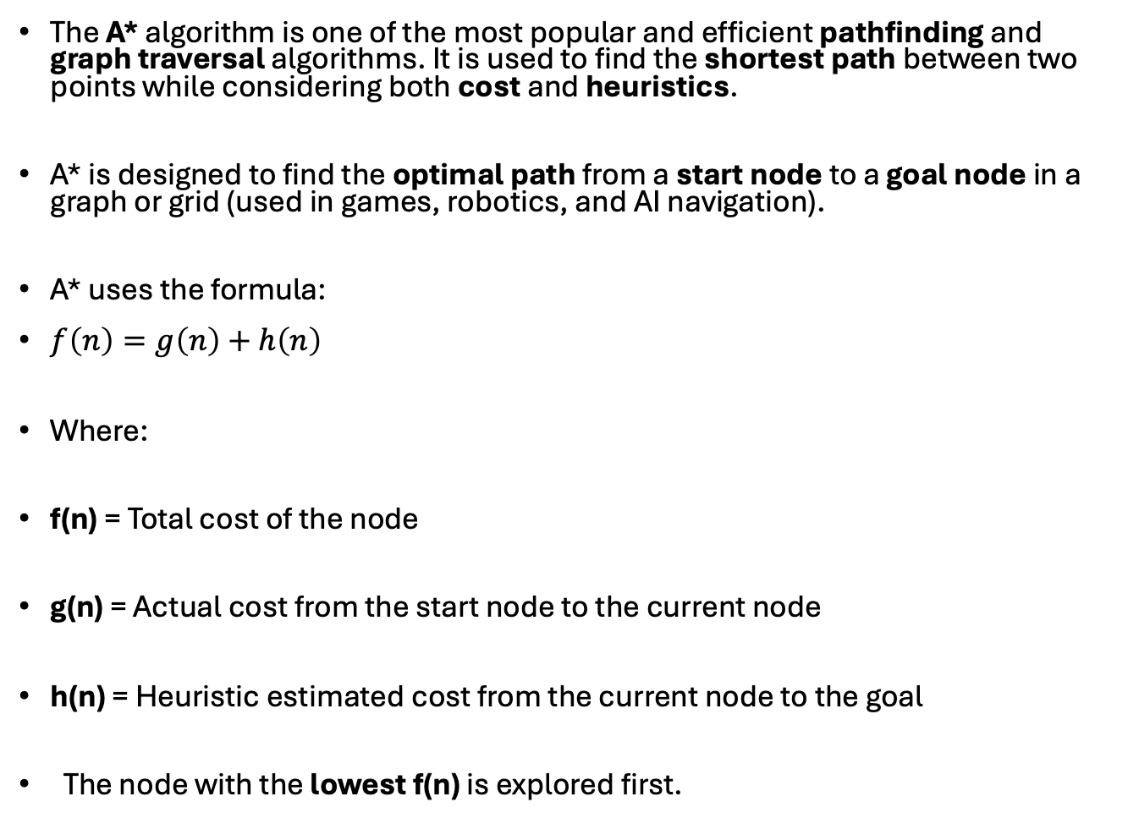
A* (A-Star) Algorithm
The A* algorithm is one of the most popular and efficient pathfinding and graph traversal algorithms. It is used to find the shortest path between two points while considering both cost and heuristics.
A* is designed to find the optimal path from a start node to a goal node in a graph or grid (used in games, robotics, and AI navigation).
A* uses the formula:
$f\left(n\right)=g\left(n\right)+h\left(n\right)$
Where:
f(n) = Total cost of the node
g(n) = Actual cost from the start node to the current node
h(n) = Heuristic estimated cost from the current node to the goal
The node with the lowest f(n) is explored first.

Slide 8
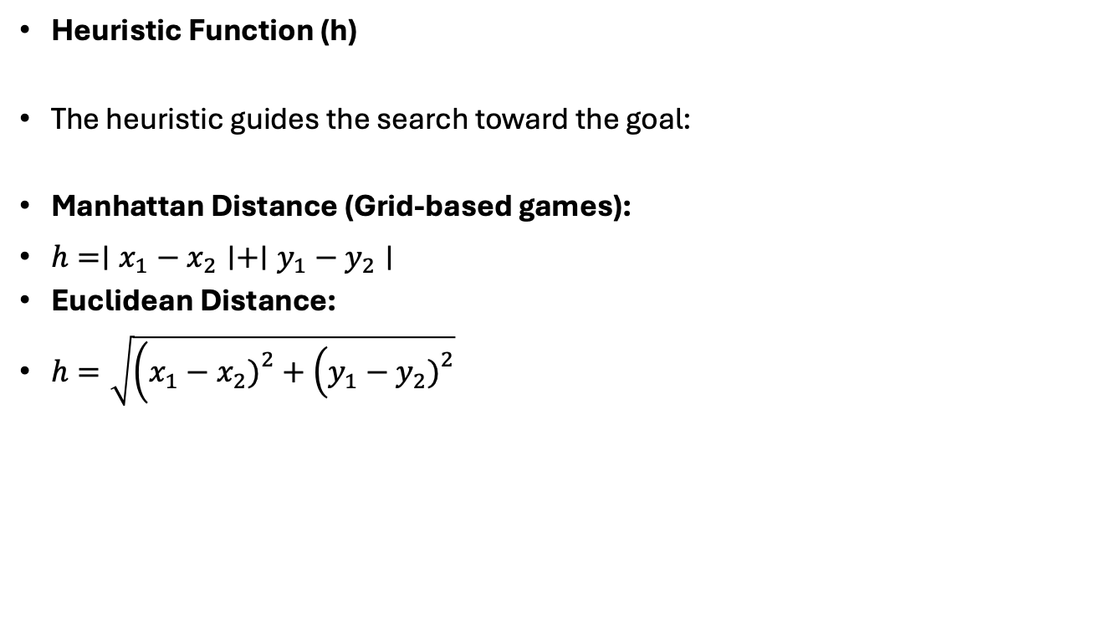
Heuristic Function (h)
The heuristic guides the search toward the goal:
Manhattan Distance (Grid-based games):
$h=∣x_{1}−x_{2}∣+∣y_{1}−y_{2}∣$
Euclidean Distance:
$h=\sqrt{\left(x_{1}−x_{2}{\left.)\right.}^{2}+\left(y_{1}−y_{2}{\left.)\right.}^{2}\right.\right.}$

Slide 9
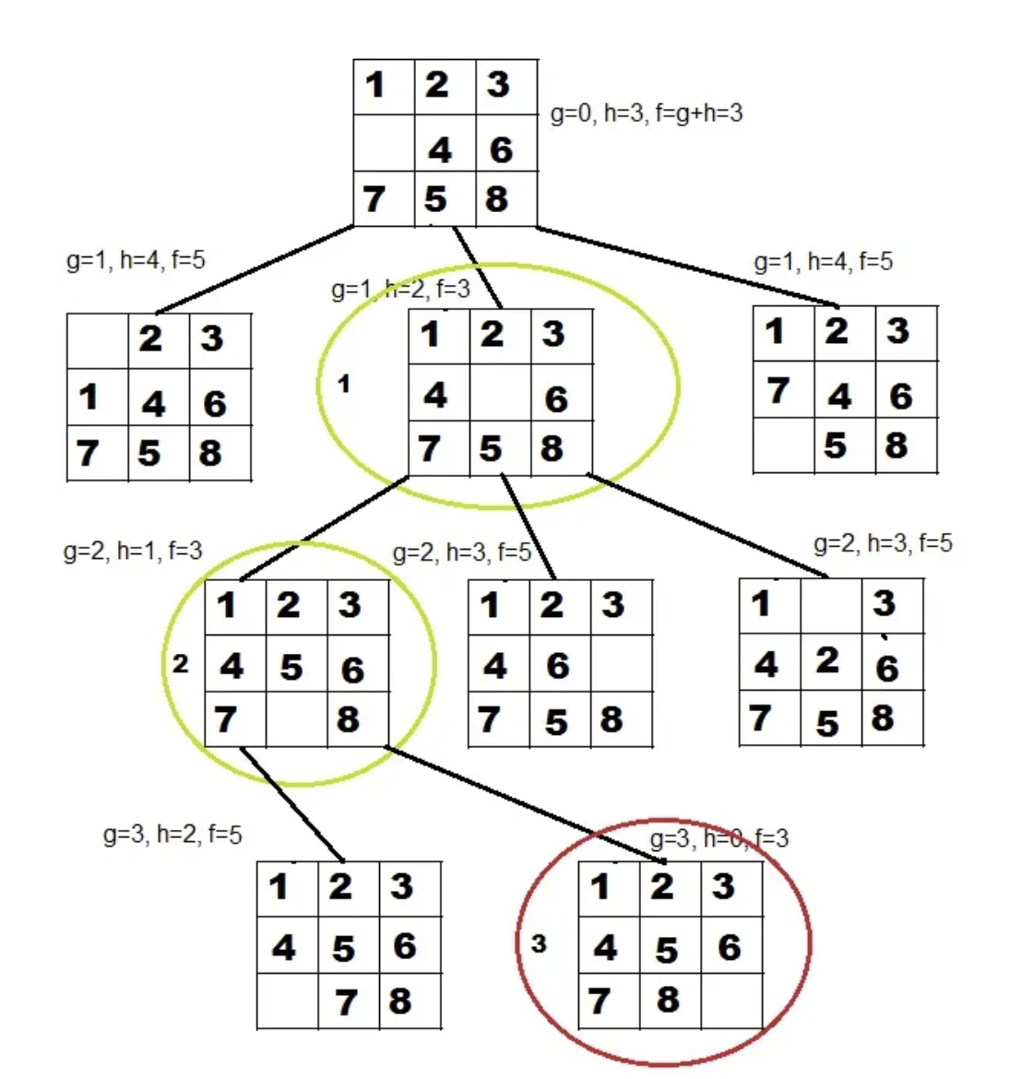
How A* solves the 8-Puzzle problem.

Slide 10
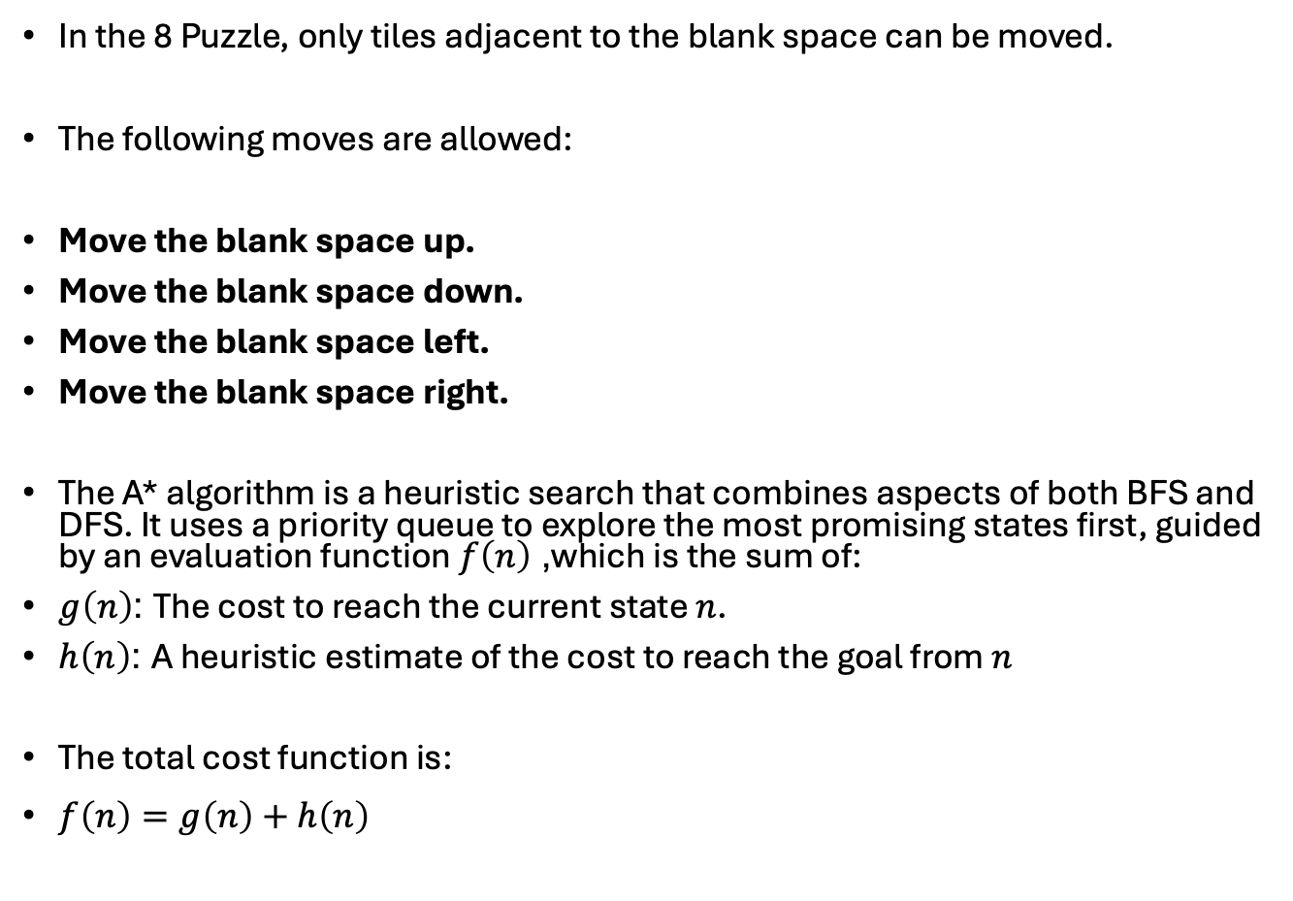
In the 8 Puzzle, only tiles adjacent to the blank space can be moved.
The following moves are allowed:
Move the blank space up.
Move the blank space down.
Move the blank space left.
Move the blank space right.
The A* algorithm is a heuristic search that combines aspects of both BFS and DFS. It uses a priority queue to explore the most promising states first, guided by an evaluation function $f\left(n\right)$, which is the sum of:
$g\left(n\right)$: The cost to reach the current state $n$.
$h\left(n\right)$: A heuristic estimate of the cost to reach the goal from $n$
The total cost function is:
$f\left(n\right)=g\left(n\right)+h\left(n\right)$

Slide 11
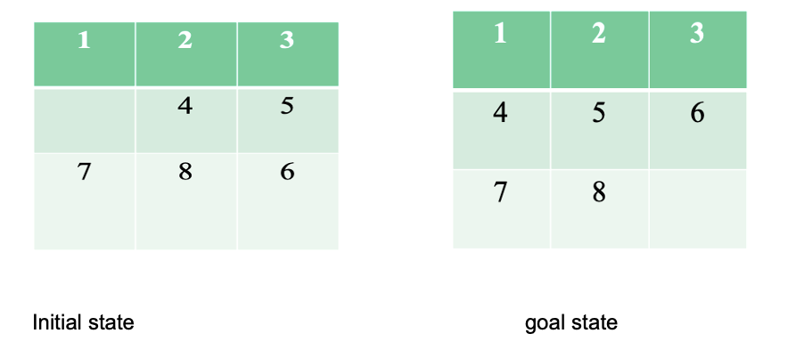
The A* algorithm uses heuristics to efficiently explore the state space and find an optimal solution faster than BFS or DFS.
Advantage: A* guarantees finding the shortest path to the goal if an admissible heuristic is used.
Disadvantage: A* can be slow if the heuristic is not well-chosen.

Slide 12
Minimax
Minimax is a backtracking algorithm used in decision-making and game theory to determine the best move for a player, provided that your opponent also plays optimally. It is commonly employed in two-player turn-based games like Tic-Tac-Toe, Backgammon, Mancala, and Chess.
Minimax is a decision rule used in AI, decision theory, game theory, statistics, and philosophy to minimize the potential loss in the worst-case (maximum loss) scenario. When dealing with gains, it is referred to as "maximin" – to maximize the lowest gain. Initially developed for several-player zero-sum game theory, it has been extended to more complicated games and general decision-making under uncertainty.

Slide 13
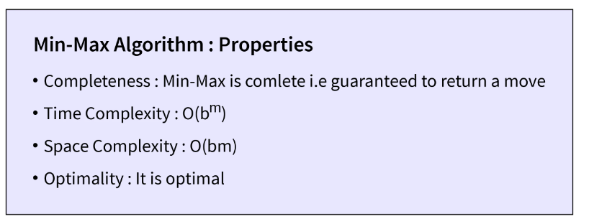
The minimax algorithm is a key technique in adversarial search, especially in two-player zero-sum games like Tic-Tac-Toe. It employs the concepts of maximizing and minimizing players to determine the best possible moves for each player, considering the opponent's strategies.
– Backtracking algorithm.
– Best move strategy used.
– Max will try to maximize its utility(best move).
– Min will try to minimize utility(worst move).
d= Depth, b= Branching Factor

Slide 14
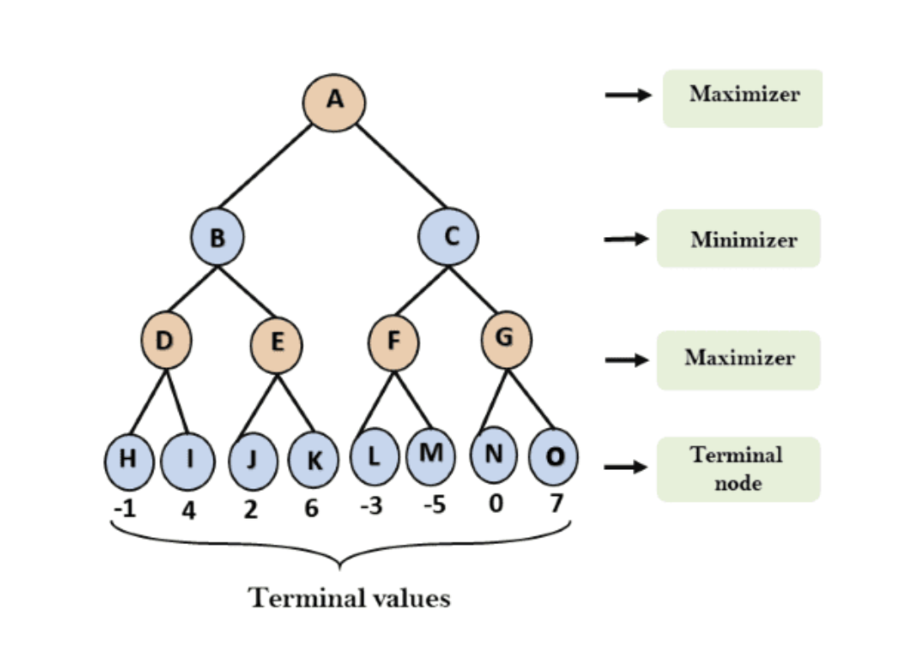

Slide 15
Alpha-Beta Pruning (in Game AI)
Alpha-Beta Pruning is an optimization technique for the Minimax algorithm used in two-player games (like chess, tic-tac-toe, or checkers).
It helps reduce the number of nodes evaluated in the game tree without affecting the final result.
Basic Concept
The Minimax Algorithm explores all possible game moves to find the best strategy assuming both players play optimally:
MAX player tries to maximize the score.
MIN player tries to minimize the score.
However, searching all nodes is computationally expensive — Alpha-Beta Pruning skips branches that cannot influence the final decision.

Slide 16
Key Terms
Term | Meaning
α (Alpha) | The best value that the MAX player can guarantee so far.
β (Beta) | The best value that the MIN player can guarantee so far.
Pruning | Stopping evaluation of a branch when it can’t produce a better result than previously explored branches.

Slide 17
Working Principle
Traverse the game tree using depth-first search.
Maintain two values: alpha and beta.
At a MAX node:
  Update alpha = max(alpha, value).
  Prune remaining children if alpha ≥ beta.
At a MIN node:
  Update beta = min(beta, value).
  Prune remaining children if beta ≤ alpha.

Slide 18
Alpha-Beta Pruning (in Game AI)

Slide 19
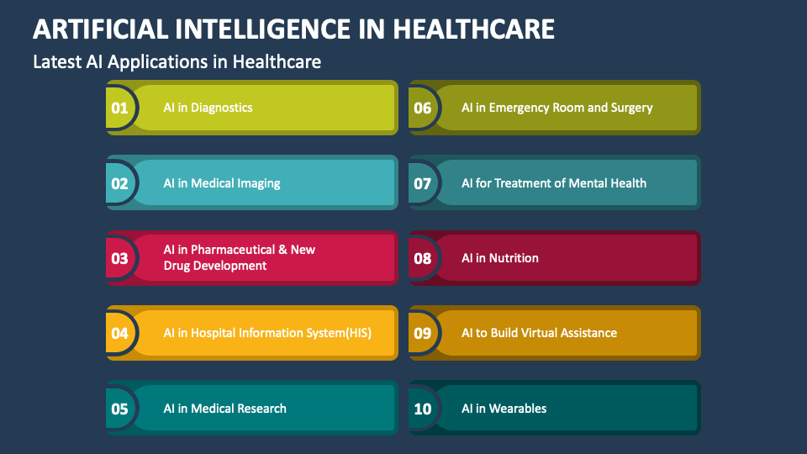
AI Applications in Healthcare

Slide 20
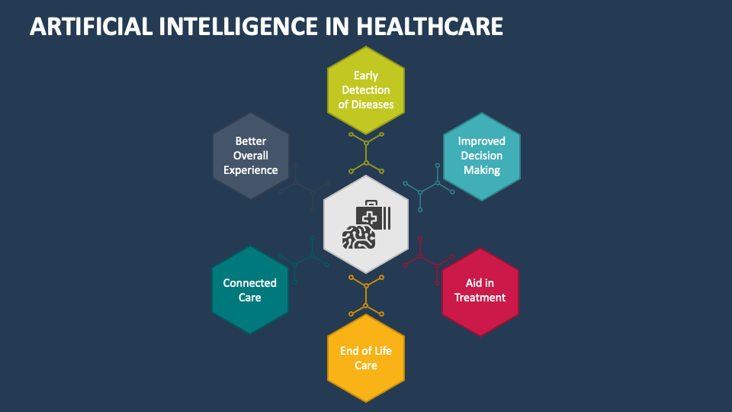

Slide 21
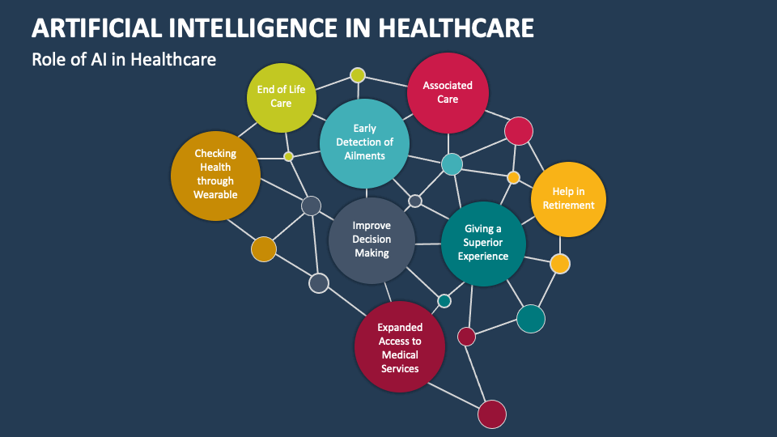
Role of AI in Healthcare

Slide 22
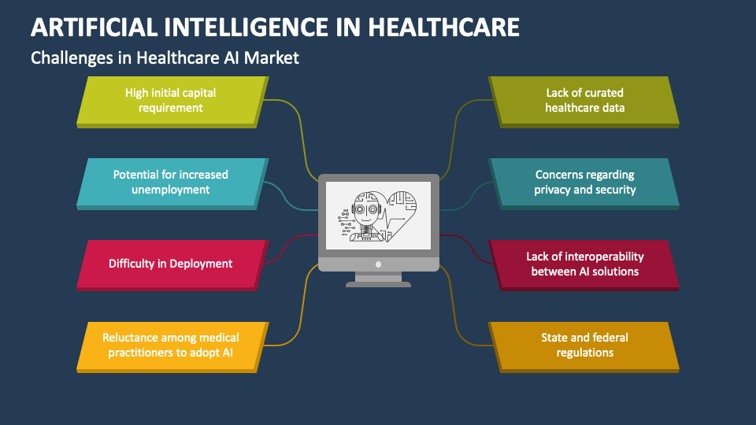

Slide 23
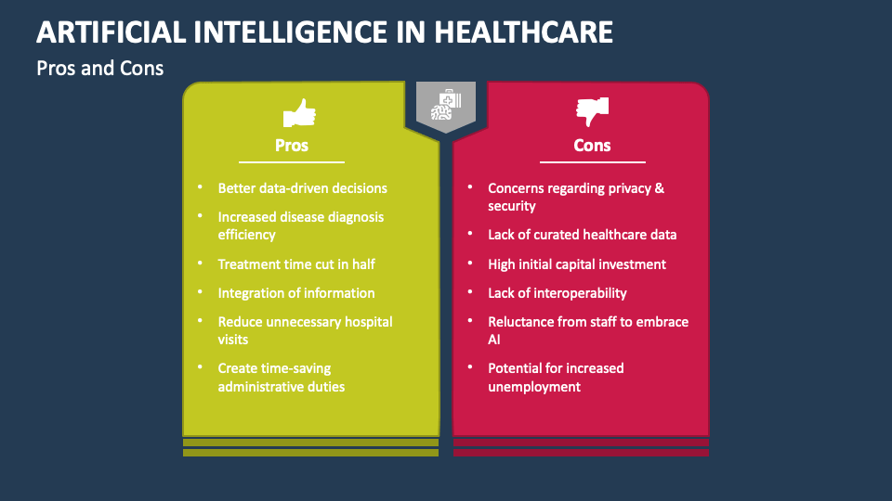

Slide 24
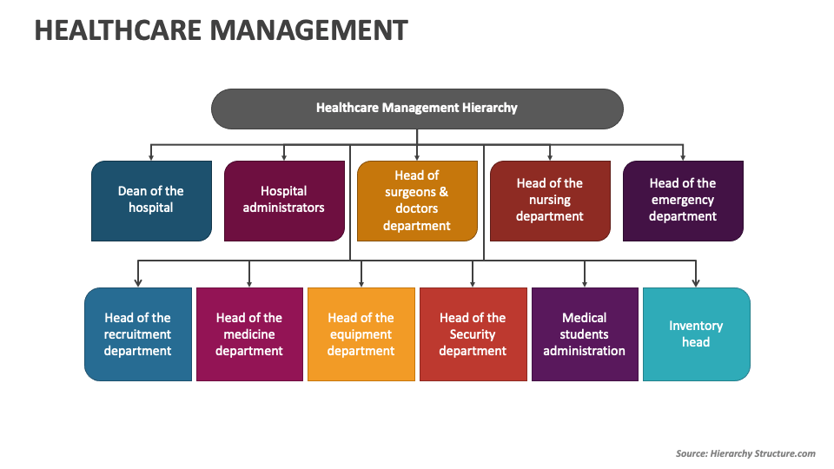

Slide 25
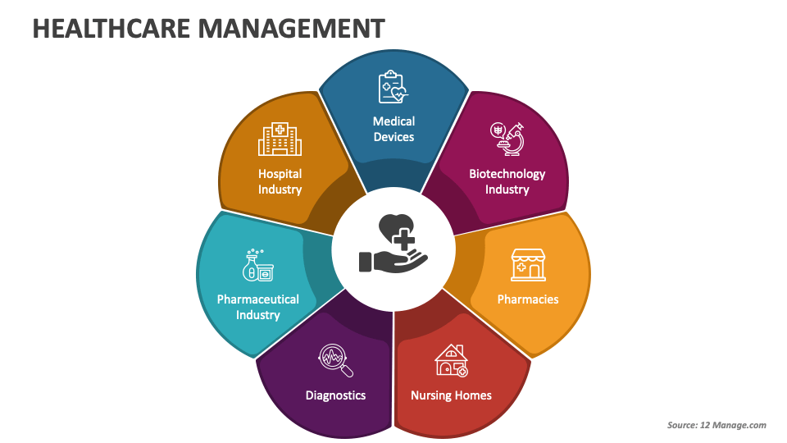

Slide 26
AI Applications in Healthcare, organized by key domains and examples:
Medical Imaging and Diagnostics
AI is transforming how diseases are detected and diagnosed using imaging data.
Applications:
Disease Detection: Identifying tumors, fractures, and anomalies in X-rays, MRI, and CT scans.
Cancer Diagnosis: Deep learning models (CNNs, GNNs, Transformers) are used for liver, lung, and breast cancer detection.
Retinal Scans: Detecting diabetic retinopathy and glaucoma from eye images.
Examples:
Google Health’s AI model for breast cancer detection.
IBM Watson’s medical imaging AI for radiology reports.

Slide 27
Drug Discovery and Development
AI accelerates the drug development process by predicting molecular behavior and reducing trial costs.
Applications:
Drug Target Identification: Predicting how molecules will interact with biological targets.
Molecular Simulation: AI models simulate protein folding (e.g., DeepMind’s AlphaFold).
Clinical Trial Optimization: Identifying suitable candidates and predicting success rates.

Slide 28
Predictive Analytics and Disease Forecasting
AI models analyze large-scale health data to predict disease outbreaks or patient deterioration.
Applications:
Predicting heart attacks, stroke, or diabetes risk using patient history.
Forecasting epidemics and pandemics using population data and mobility patterns.
Example:
BlueDot’s AI detected COVID-19 outbreak patterns before global spread.

Slide 29
Hospital Management and Workflow Automation
AI improves healthcare efficiency and reduces administrative burden.
Applications:
Appointment Scheduling and Bed Allocation Optimization.
Automated Billing and Medical Record Summarization.
Chatbots and Virtual Assistants for patient support.
Example:
Microsoft’s Health Bot Service for healthcare triage.

Slide 30
Virtual Health Assistants and Chatbots
AI-powered assistants support patients and doctors.
Applications:
Symptom Checkers (e.g., Ada Health, Babylon Health).
Medication Reminders and Remote Monitoring.
Mental Health Chatbots (e.g., Woebot, Wysa).

Slide 31
Remote Monitoring and Wearable Devices
AI integrates with IoT to monitor patient vitals continuously.
Applications:
Detecting abnormal heart rhythms, sleep apnea, and stress levels.
Early detection of chronic conditions.
Examples:
Apple Watch detecting atrial fibrillation.
Fitbit predicting stress and fatigue levels.

Slide 32
Surgery and Robotics
AI-assisted surgical robots for precision
3D visualization for preoperative planning
Example: da Vinci Surgical System

Slide 33
AI in Robotics and Autonomous Systems
Artificial Intelligence (AI) is the "brain" that enables modern robotics and autonomous systems to operate intelligently, making them capable of learning, reasoning, adapting, and making decisions without continuous human control. This integration transforms simple programmable machines into versatile, intelligent entities.
AI in Robotics and Autonomous Systems: Core Concepts
While robotics is the branch of technology dealing with the physical robot (the machine, sensors, and actuators), and an autonomous system is a machine or technology that can operate without continuous human supervision, AI provides the intelligence that enables their advanced functions.

Slide 34
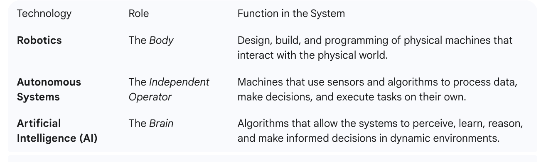

Slide 35
Definition:
Artificial Intelligence (AI): Simulation of human intelligence in machines enabling learning, reasoning, and problem-solving.
Robotics: Branch of engineering that involves the conception, design, construction, and operation of robots.
Autonomous Systems: Machines capable of performing tasks without human intervention using AI algorithms and sensors.
Goal: To create intelligent robots capable of perceiving their environment, making decisions, and acting autonomously.

Slide 36
Key AI Technologies Driving Autonomy
Computer Vision (CV): Allows the system to perceive and interpret its environment by processing visual data from cameras and other sensors (LiDAR, radar). This is critical for tasks like object recognition, quality control, and visual navigation (e.g., Simultaneous Localization and Mapping - SLAM).
Machine Learning (ML) & Deep Learning: Enables systems to learn from experience and data, continually improving their performance. Reinforcement Learning, a key type of ML, is used to train robots to perform complex tasks by rewarding successful actions (trial and error).
Natural Language Processing (NLP) & Conversational AI: Allows robots to understand and respond to human language and speech. This facilitates more intuitive human-robot interaction in customer service, healthcare, and collaborative robotics (Cobots).

Slide 37
Decision-Making Algorithms: The core logic that analyzes processed data (perception) and environmental constraints to select the optimal action for the system's goals, enabling autonomous navigation, path planning, and obstacle avoidance.
Edge AI: Processing sensor data locally on the robot/vehicle in real-time. This allows for fast, agile decision-making without the latency of cloud computing, which is vital for safe and reliable autonomous operation, such as in self-driving cars.

Slide 38
Applications Across Industries
Transportation & Logistics
Autonomous Vehicles (AVs) and Drones: AI is responsible for real-time perception of the road, prediction of other agents' behavior, and safe navigation.
Warehouse Automation: Autonomous Mobile Robots (AMRs) use AI to navigate complex, dynamic warehouse floors, optimize routes, and handle picking and sorting tasks.
Healthcare
Surgical Robots: AI enhances the precision of robotic arms, assisting surgeons in minimally invasive procedures and reducing human error.
Patient Care: AI-powered companion robots and diagnostic systems assist with monitoring, therapy, and delivering supplies.
Manufacturing & Industry
Collaborative Robots (Cobots): AI allows these robots to safely and effectively work directly alongside humans, adapting to human workflows and performing repetitive or strenuous tasks.
Quality Control: Intelligent vision systems use AI to inspect products for defects with high speed and accuracy, surpassing human capabilities.
Predictive Maintenance: AI algorithms monitor equipment sensors to predict failures before they occur, maximizing uptime.

Slide 39
Agriculture
Precision Farming: Autonomous drones and ground vehicles use computer vision to monitor crop health, assess ripeness, target weeds for removal (reducing herbicide use), and optimize irrigation.
Defense & Aerospace
Unmanned Systems: AI enables Unmanned Aerial Vehicles (UAVs), Unmanned Ground Vehicles (UGVs), and Unmanned Underwater Vehicles (UUVs) to perform reconnaissance, surveillance, and data collection in hazardous or inaccessible environments with minimal human intervention.

Slide 40
AI in Robotics and Autonomous Systems
Artificial Intelligence (AI) enables robots and autonomous systems to perceive, reason, and act intelligently within their environment.
Combines machine learning, computer vision, sensor fusion, and control algorithms.
Goal: Create machines that can operate independently, adapt to changes, and learn from experience.

Slide 41
Key AI Components in Robotics
Component | Description
Perception | Using sensors (camera, LiDAR, ultrasonic, radar) to perceive the environment.
Planning | Generating motion or task plans to achieve goals.
Learning | Using ML/DL algorithms to improve performance over time.
Reasoning | Making logical decisions based on sensory input and objectives.
Control | Executing planned actions with precision.

Slide 42
Applications in Autonomous Systems
Autonomous Vehicles
AI enables self-driving cars, drones, and delivery robots.
Uses sensor fusion (LiDAR, cameras, GPS) and deep learning for object detection and navigation.
Example: Tesla Autopilot, Waymo, Baidu Apollo.
b. Industrial Robotics
Used in manufacturing for assembly, welding, packaging, inspection.
AI adds flexibility — robots can learn new tasks and collaborate with humans (cobots).
Example: FANUC and KUKA robots with machine vision.

Slide 43
c. Healthcare Robots
Surgical robots, rehabilitation devices, and patient care bots.
AI enhances precision and safety (e.g., da Vinci Surgical System, exoskeletons).
d. Service and Domestic Robots
AI-powered robots for cleaning, delivery, customer service.
Example: SoftBank’s Pepper, Amazon’s Astro, Roomba.
e. Space and Defense Robots
Autonomous rovers (e.g., NASA’s Perseverance), underwater exploration drones.
AI assists in path planning, fault detection, and decision-making in remote environments.

Slide 44
Core AI Techniques Used
Technique | Application
Computer Vision (CNNs, Transformers) | Object recognition, tracking, scene understanding
Reinforcement Learning (RL) | Autonomous decision-making and navigation
SLAM (Simultaneous Localization and Mapping) | Building environment maps while tracking location
Natural Language Processing (NLP) | Human-robot interaction (voice commands, chatbots)
Deep Learning (DL) | Sensor data interpretation, motion control

Slide 45
AI-Driven Innovations in Finance
Artificial Intelligence (AI) in finance involves using machine learning, data analytics, and automation to enhance financial services, decision-making, and customer experience.
Goal:
Improve accuracy, efficiency, risk management, and personalization in financial operations.

Slide 46
Role of AI in the Financial Sector
AI technologies are revolutionizing:
Banking operations
Investment management
Insurance
Risk assessment
Fraud detection
Customer services

Slide 47
Core AI Technologies in Finance
Technology | Application
Machine Learning (ML) | Predictive analytics, credit scoring, algorithmic trading
Deep Learning (DL) | Image/text data analysis, fraud detection
Natural Language Processing (NLP) | Chatbots, sentiment analysis from financial news
Robotic Process Automation (RPA) | Automating repetitive banking and compliance tasks
Predictive Analytics | Market trend forecasting and portfolio management

Slide 48
Key Applications
Fraud Detection and Prevention
Detects unusual transaction patterns using ML.
Real-time alerts reduce financial losses.
Example: AI systems in Visa and Mastercard detect anomalies in milliseconds.
Algorithmic and High-Frequency Trading
AI models analyze large datasets to make instant trading decisions.
Incorporates sentiment, news, and price signals.
Example: Goldman Sachs and Morgan Stanley use AI for trading optimization.

Slide 49
Credit Scoring and Risk Assessment
AI evaluates non-traditional data (e.g., spending habits, online behavior).
Enables fairer, faster loan approvals.
Example: ZestFinance, Upstart.
Personalized Banking
AI-driven recommendation systems suggest financial products tailored to user behavior.
Chatbots and virtual assistants (e.g., Erica by Bank of America).

Slide 50
Regulatory Compliance and Anti-Money Laundering (AML)
AI systems monitor compliance automatically.
Pattern recognition detects suspicious financial networks.
Wealth Management and Robo-Advisors
AI-based advisors automate portfolio management.
Example: Betterment, Wealthfront.

Slide 51
Advantages
Efficiency & Automation – Reduces manual workload
Accuracy – AI models handle massive data precisely
Fraud Reduction – Early anomaly detection
Personalization – Enhanced customer experience
Data-Driven Decision Making – Improved insights for investors and banks
Challenges and Ethical Concerns
Data Privacy – Sensitive financial data security
Bias in Algorithms – Potential for unfair lending decisions
Model Transparency – Black-box problem in AI predictions
Cybersecurity Risks – AI systems can be exploited
Regulatory Uncertainty – Compliance with evolving laws (e.g., GDPR, RBI, SEC)

Slide 52
AI for Business Optimization
Artificial Intelligence (AI) is a powerful driver for business optimization, enabling companies to enhance efficiency, reduce costs, improve decision-making, and create superior customer experiences.
The core ways AI optimizes business operations are through automation, data analytics, and predictive capabilities.

Slide 53
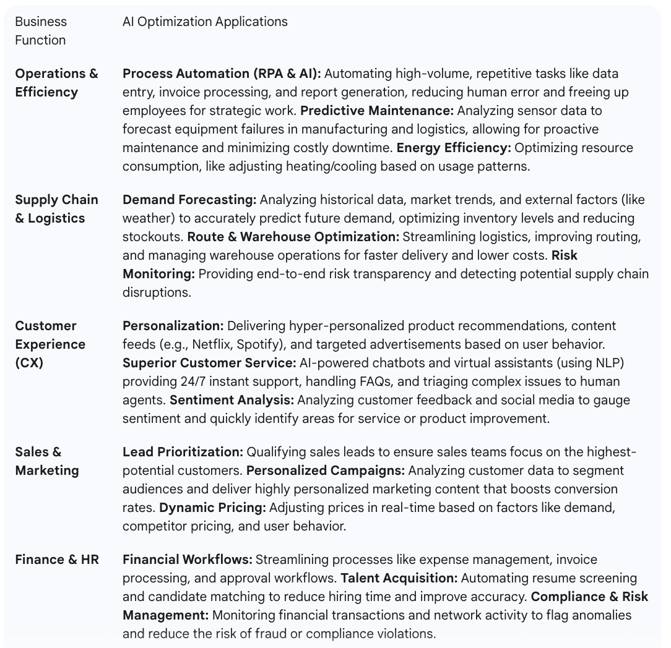
Key Applications and Use Cases for Business Optimization

Slide 54
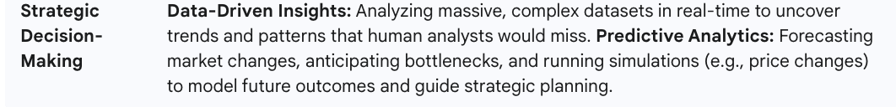

Slide 55
Core Benefits of AI for Business Optimization
Increased Efficiency and Productivity: AI automates routine tasks, allowing human employees to concentrate on high-value, strategic, and creative work.
Cost Reduction: Automation minimizes labor costs, reduces human error (cutting down on rework), and optimizes resource use across operations and the supply chain.
Improved Accuracy and Quality: AI systems maintain consistent performance, significantly reduce human errors in data processing and quality control, and deliver high-quality, real-time insights.
Enhanced Customer Experience: Personalization, 24/7 support, and faster response times lead to higher customer satisfaction, loyalty, and increased sales (e.g., via cross-selling/up-selling recommendations).
Smarter Decision-Making: AI provides objective, data-driven insights and predictive forecasts, empowering leaders to make faster, more informed, and strategic decisions that adapt to changing market conditions.
Competitive Advantage: Businesses that leverage AI can innovate faster, adapt more quickly, and deliver better products and services, creating a clear competitive edge in their market.

Slide 56
AI Techniques in Marketing
Artificial Intelligence (AI) has become a transformative force in marketing, enabling businesses to gather deeper customer insights, personalize experiences at scale, and automate complex tasks. The core AI techniques driving this revolution are based on various sub-fields of AI and their applications.

Slide 57
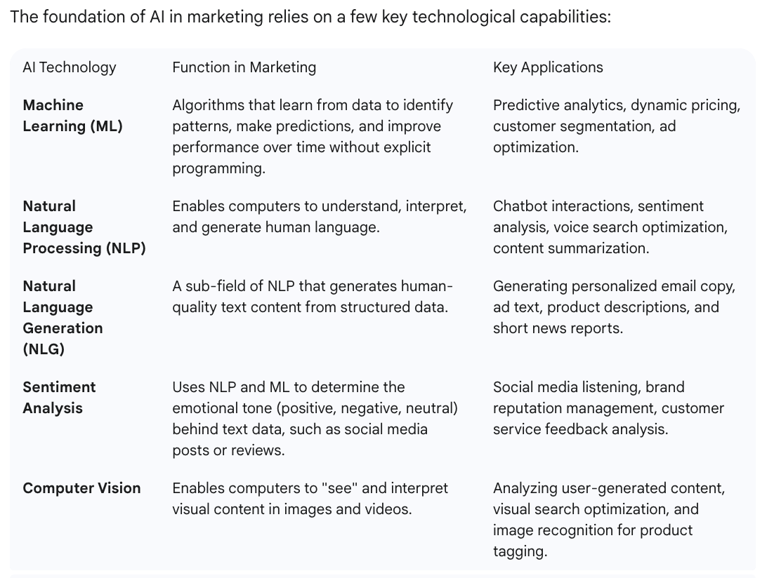
Core AI Technologies Enabling Marketing

Slide 58
Core AI Techniques Used in Marketing
AI Technique | Description | Application
Machine Learning (ML) | Learns patterns from customer data | Predicting customer churn, sales forecasting
Natural Language Processing (NLP) | Analyzes and understands human language | Sentiment analysis, chatbots, feedback analysis
Deep Learning (DL) | Neural networks for image, speech, and behavior recognition | Ad targeting, image recognition in ads
Predictive Analytics | Uses past data to forecast future outcomes | Demand forecasting, lead scoring
Reinforcement Learning | Learns best actions through feedback | Dynamic pricing, ad optimization
Computer Vision | Analyzes visual content | Product tagging, visual search in e-commerce
Generative AI | Creates new content using AI models | Automated ad copy, images, videos, and blogs

Slide 59
Case Studies
Company | AI Application | Outcome
Netflix | Predictive algorithms for recommendations | 80% of views come from recommendations
Coca-Cola | AI-driven content creation and sentiment analysis | Boosted engagement rates
Amazon | Personalized product recommendations | 35% of sales from recommendation engine
Sephora | Virtual try-on and AI chatbots | Enhanced customer satisfaction

Slide 60
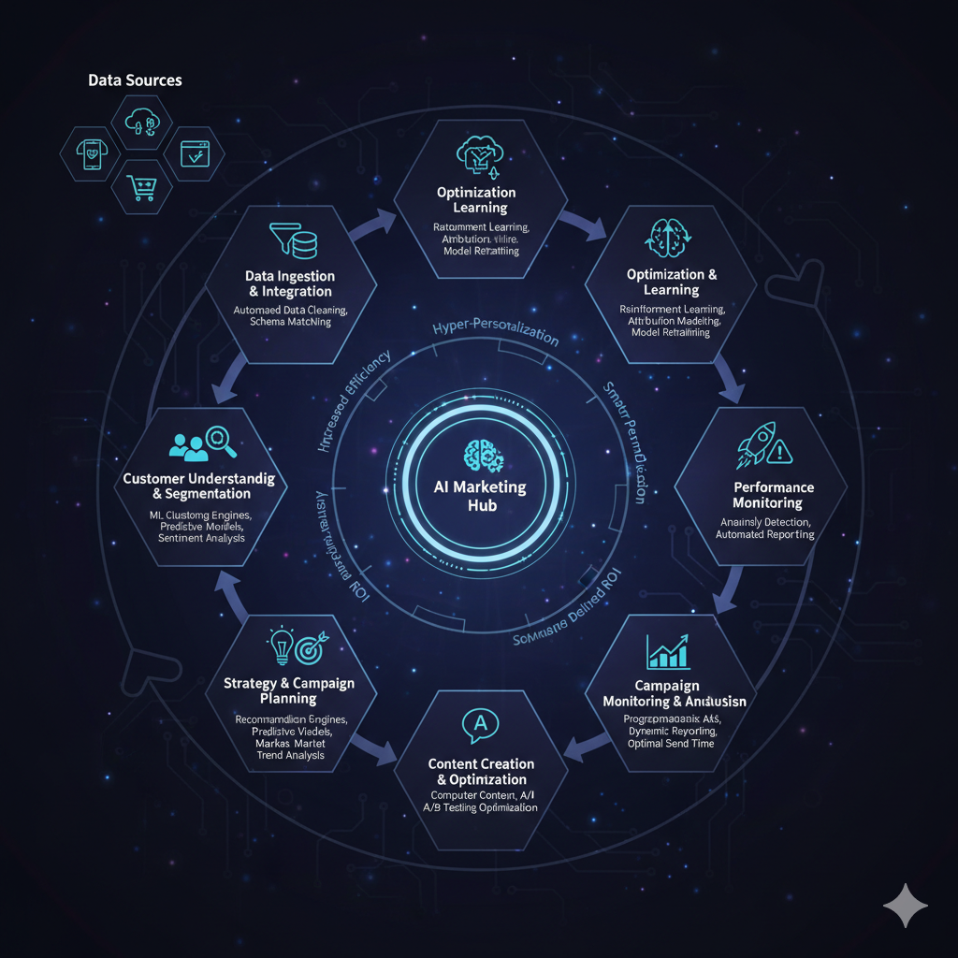

Slide 61
AI in Educational Technology
Definition:
Artificial Intelligence (AI) in Educational Technology refers to the integration of intelligent algorithms and data-driven systems to enhance learning, teaching, and administration.
Goal:
To provide personalized learning experiences, automate administrative tasks, and improve educational outcomes using AI tools and analytics.

Slide 62
Key AI Technologies Used in EdTech
Technology | Function | Example Application
Machine Learning (ML) | Learns from student data to personalize content | Adaptive learning systems
Natural Language Processing (NLP) | Enables interaction through human language | Chatbots, essay grading
Computer Vision | Visual recognition for monitoring and engagement | Online proctoring, gesture tracking
Speech Recognition | Converts spoken language into text | Voice-based learning tools
Reinforcement Learning | Optimizes teaching paths dynamically | Intelligent tutoring systems
Generative AI | Creates educational materials | Auto-generated quizzes, notes, and summaries

Slide 63
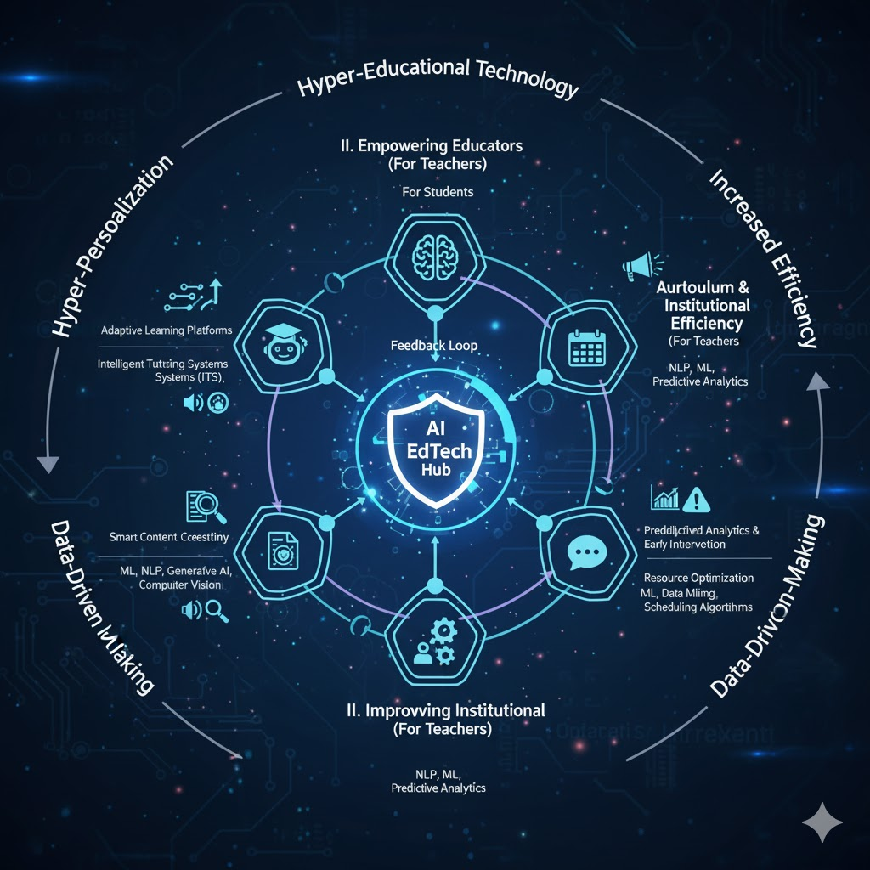

Slide 64
Case Studies
Institution / Platform | AI Application | Impact
Coursera / EdX | Adaptive course recommendations | Improved learner engagement
Duolingo | AI-based language tutoring | Personalized skill improvement
Carnegie Learning | Intelligent tutoring for math | Increased student success rates
Turnitin | AI plagiarism detection | Improved academic integrity
Open Learning | Predictive analytics | Identified struggling learners early

Slide 65
AI Solutions for Smart Agriculture
Definition:
Artificial Intelligence (AI) in Smart Agriculture refers to the use of intelligent systems, data analytics, sensors, and machine learning algorithms to monitor, analyze, and optimize agricultural operations.
Goal:
To increase crop productivity, resource efficiency, and sustainability through data-driven decision-making and automation.

Slide 66
Why AI in Agriculture?
Traditional Challenges | AI-Driven Solutions
Unpredictable weather and soil conditions | Predictive analytics for climate and soil
Resource wastage (water, fertilizer, pesticides) | AI-based precision farming
Labor shortage | Agricultural robotics and automation
Crop diseases and pest outbreaks | Computer vision for early detection
Market uncertainty | AI-based price forecasting

Slide 67
Key AI Technologies Used in Agriculture
Technology | Application
Machine Learning (ML) | Crop yield prediction, weather forecasting
Computer Vision | Plant disease detection, weed identification
Deep Learning | Drone and satellite image analysis
IoT (Internet of Things) | Smart sensors for soil, water, and weather monitoring
Robotics & Automation | Autonomous tractors, drones, and harvesters
Predictive Analytics | Crop and price forecasting
Natural Language Processing (NLP) | Chatbots for farmer advisory services

Slide 68
Major Applications of AI in Smart Agriculture
A. Precision Farming
AI combines sensor data and satellite imagery to optimize irrigation, fertilization, and pesticide use.
Example: John Deere’s See & Spray technology identifies and targets weeds precisely.
B. Crop Monitoring and Disease Detection
Computer vision models detect pests, nutrient deficiencies, and diseases from leaf images.
Example: Plantix app identifies over 100 plant diseases using AI.
C. Predictive Analytics for Yield and Weather
ML models predict crop yield and weather risks based on historical data.
Helps in planning sowing and harvesting schedules.

Slide 69
D. Smart Irrigation Systems
IoT sensors and AI algorithms control water usage based on soil moisture and weather conditions.
Example: Arable Mark and CropX optimize irrigation decisions.
E. Autonomous Machines and Robots
AI-powered drones for aerial monitoring and pesticide spraying.
Autonomous tractors and robotic harvesters reduce manual labor.
F. Supply Chain Optimization
AI predicts demand and optimizes logistics and storage conditions.
Example: AI platforms forecast crop prices and detect spoilage.
G. Farmer Advisory and Decision Support
Chatbots and voice assistants guide farmers on crop selection, weather alerts, and pest control.
Example: IBM Watson Decision Platform for Agriculture.

Slide 70
Benefits of AI in Agriculture
Increased Productivity – Better yield through data-driven insights
Resource Optimization – Efficient use of water, fertilizers, and energy
Early Disease Detection – Prevents losses using predictive alerts
Reduced Labor Cost – Automation of repetitive tasks
Sustainability – Supports eco-friendly and climate-resilient farming

Slide 71
Challenges and Limitations
High Cost of Technology – Limited access for small-scale farmers
Data Availability & Quality – Need for reliable, labeled datasets
Infrastructure Gaps – Poor connectivity in rural areas
Skill Gap – Farmers’ lack of AI and digital literacy
Ethical & Privacy Issues – Data ownership concerns

Slide 72
Future Trends in AI Agriculture
AI + IoT (AgroTech) – Integrated sensor networks
Autonomous Farming Systems – Self-driving tractors, robotic planters
AI for Climate-Resilient Agriculture – Predicting and adapting to climate change
Drone Swarms – Coordinated drone operations for large-scale monitoring
Blockchain + AI – Transparent supply chain and traceability

Slide 73
Case Studies
Organization / Project | AI Application | Outcome
John Deere | Computer vision for weed detection | Reduced pesticide usage
IBM Watson | Predictive analytics & farm management | Improved crop planning
Microsoft AI Sowing App (India) | AI + weather data for sowing time | 30% higher yield
Blue River Technology | Smart spraying robots | Precision pesticide application
CropIn | AI-based farm monitoring platform | Real-time crop health data

